Slide 1
Fall 2024 BSCS Lecture 04 Network Performance(Delay, Loss, Throughput) and Security
National University of Computer & Emerging Sciences

Slide 2

Chapter 1: roadmap
What is the Internet?
What is a protocol?
Network edge: hosts, access network, physical media
Network core: packet/circuit switching, internet structure
Performance: loss, delay, throughput
Security
Protocol layers, service models
History

Slide 3

How do packet delay and loss occur?
packets queue in router buffers, waiting for turn for transmission
queue length grows when arrival rate to link (temporarily) exceeds output link capacity
packet loss occurs when memory to hold queued packets fills up
packet being transmitted (transmission delay)
A
B
packets in buffers (queueing delay)
free (available) buffers: arriving packets
dropped (loss) if no free buffers

Slide 4
Packet delay: four sources
transmission
A
propagation
B
nodal
processing
queueing
d_{nodal} = d_{proc} + d_{queue} + d_{trans} + d_{prop}
d_{proc}: nodal processing
check bit errors
determine output link
typically < microsecs
d_{queue}: queueing delay
time waiting at output link for transmission
depends on congestion level of router

Slide 5
Packet delay: four sources
transmission
A
propagation
B
nodal
processing
queueing
d_{nodal} = d_{proc} + d_{queue} + d_{trans} + d_{prop}
d_{trans}: transmission delay:
L: packet length (bits)
R: link transmission rate (bps)
d_{trans} = L/R
d_{prop}: propagation delay:
d: length of physical link
s: propagation speed (~2x10⁸ m/sec)
d_{prop} = d/s
d_{trans} and d_{prop}
very different

Slide 6

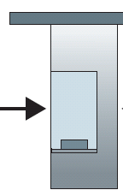
Caravan analogy
100 km
100 km
ten-car caravan
(aka 10-bit packet)
toll booth
toll booth
toll booth
toll booth
(aka link)
toll booth
car ~ bit; caravan ~ packet; toll service ~ link transmission
toll booth takes 12 sec to service car (bit transmission time)
“propagate” at 100 km/hr
Q: How long until caravan is lined up before 2nd toll booth?
time to “push” entire caravan through toll booth onto highway = 12*10 = 120 sec
time for last car to propagate from 1st to 2nd toll both: 100km/(100km/hr) = 1 hr
A: 62 minutes

Slide 7
Caravan analogy
100 km
100 km
ten-car caravan
(aka 10-bit packet)
toll booth
(aka router)
toll booth
suppose cars now “propagate” at 1000 km/hr
and suppose toll booth now takes one min to service a car
Q: Will cars arrive to 2nd booth before all cars serviced at first booth?
A: Yes! after 7 min, first car arrives at second booth; three cars still at first booth

Slide 8

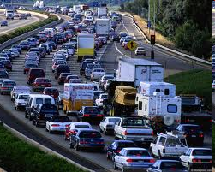
Packet queueing delay (revisited)
a: average packet arrival rate
L: packet length (bits)
R: link bandwidth (bit transmission rate)
average queueing delay
L
a
.
:
arrival rate of bits
“traffic
intensity”
R
service rate of bits
traffic intensity = La/R
1
La/R ~ 0: avg. queueing delay small
La/R -> 1: avg. queueing delay large
La/R > 1: more “work” arriving is more than can be serviced - average delay infinite!
La/R ~ 0
La/R -> 1

Slide 9
“Real” Internet delays and routes
what do “real” Internet delay & loss look like?
traceroute program: provides delay measurement from source to router along end-end Internet path towards destination. For all i:
sends three packets that will reach router i on path towards destination (with time-to-live field value of i)
router i will return packets to sender
sender measures time interval between transmission and reply
3 probes
3 probes
3 probes

Slide 10
Real Internet delays and routes
traceroute: gaia.cs.umass.edu to www.eurecom.fr
3 delay measurements from
gaia.cs.umass.edu to cs-gw.cs.umass.edu
1 cs-gw (128.119.240.254) 1 ms 1 ms 2 ms
2 border1-rt-fa5-1-0.gw.umass.edu (128.119.3.145) 1 ms 1 ms 2 ms
3 cht-vbns.gw.umass.edu (128.119.3.130) 6 ms 5 ms 5 ms
4 jn1-at1-0-0-19.wor.vbns.net (204.147.132.129) 16 ms 11 ms 13 ms
5 jn1-so7-0-0-0.wae.vbns.net (204.147.136.136) 21 ms 18 ms 18 ms
6 abilene-vbns.abilene.ucaid.edu (198.32.11.9) 22 ms 18 ms 22 ms
7 nycm-wash.abilene.ucaid.edu (198.32.8.46) 22 ms 22 ms 22 ms
8 62.40.103.253 (62.40.103.253) 104 ms 109 ms 106 ms
9 de2-1.de1.de.geant.net (62.40.96.129) 109 ms 102 ms 104 ms
10 de.fr1.fr.geant.net (62.40.96.50) 113 ms 121 ms 114 ms
11 renater-gw.fr1.fr.geant.net (62.40.103.54) 112 ms 114 ms 112 ms
12 nio-n2.cssi.renater.fr (193.51.206.13) 111 ms 114 ms 116 ms
13 nice.cssi.renater.fr (195.220.98.102) 123 ms 125 ms 124 ms
14 r3t2-nice.cssi.renater.fr (195.220.98.110) 126 ms 126 ms 124 ms
15 eurecom-valbonne.r3t2.ft.net (193.48.50.54) 135 ms 128 ms 133 ms
16 194.214.211.25 (194.214.211.25) 126 ms 128 ms 126 ms
17 * * *
18 * * *
19 fantasia.eurecom.fr (193.55.113.142) 132 ms 128 ms 136 ms
3 delay measurements
to border1-rt-fa5-1-0.gw.umass.edu
trans-oceanic link
looks like delays decrease! Why?
* means no response (probe lost, router not replying)
* Do some traceroutes from exotic countries at www.traceroute.org

Slide 11
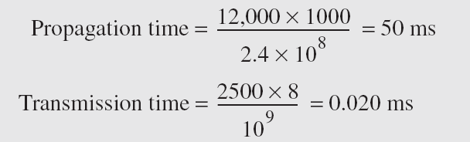
Example
What are the propagation time and the transmission time for a 2.5-kbyte message (an e-mail) if the bandwidth of the network is 1 Gbps? Assume that the distance between the sender and the receiver is 12,000 km and that light travels at 2.4 × 108 m/s.
Note that in this case, because the message is short and the bandwidth is high, the dominant factor is the propagation time, not the transmission time. The transmission time can be ignored.

Slide 12
Packet loss
queue (aka buffer) preceding link in buffer has finite capacity
packet arriving to full queue dropped (aka lost)
lost packet may be retransmitted by previous node, by source end system, or not at all
buffer
(waiting area)
packet being transmitted
A
B
packet arriving to
full buffer is lost
* Check out the Java applet for an interactive animation (on publisher’s website) of queuing and loss

Slide 13
Throughput
throughput: rate (bits/time unit) at which bits are being sent from sender to receiver
instantaneous: rate at given point in time
average: rate over longer period of time
link capacity
R_{s} bits/sec
link capacity
R_{c} bits/sec
pipe that can carry
fluid at rate
(R_{s} bits/sec)
pipe that can carry
fluid at rate
(R_{c} bits/sec)
server sends bits
(fluid) into pipe
server, with
file of F bits
to send to client

Slide 14
Throughput
R_{s} < R_{c} What is average end-end throughput?
R_{s} bits/sec
R_{c} bits/sec
R_{s} > R_{c} What is average end-end throughput?
R_{s} bits/sec
R_{c} bits/sec
bottleneck link
link on end-end path that constrains end-end throughput

Slide 15
Throughput: network scenario
per-connection end-end throughput: min(R_{c},R_{s},R/10)
in practice: R_{c} or R_{s} is often bottleneck
R_{s}
R_{s}
R_{s}
R
R_{c}
R_{c}
R_{c}
* Check out the online interactive exercises for more examples: http://gaia.cs.umass.edu/kurose_ross/
10 connections (fairly) share backbone bottleneck link R bits/sec

Slide 16
Chapter 1: roadmap
What is the Internet?
What is a protocol?
Network edge: hosts, access network, physical media
Network core: packet/circuit switching, internet structure
Performance: loss, delay, throughput
Security
Protocol layers, service models
History

Slide 17
Network security
Internet not originally designed with (much) security in mind
original vision: “a group of mutually trusting users attached to a transparent network” ☺
Internet protocol designers playing “catch-up”
security considerations in all layers!
We now need to think about:
how bad guys can attack computer networks
how we can defend networks against attacks
how to design architectures that are immune to attacks

Slide 18

Bad guys: packet interception
packet “sniffing”:
broadcast media (shared Ethernet, wireless)
promiscuous network interface reads/records all packets (e.g., including passwords!) passing by
A
C
src:B dest:A payload
B
Wireshark software used for our end-of-chapter labs is a (free) packet-sniffer

Slide 19
Bad guys: fake identity
IP spoofing: injection of packet with false source address
A
C
src:B dest:A payload
B

Slide 20
Bad guys: denial of service
Denial of Service (DoS): attackers make resources (server, bandwidth) unavailable to legitimate traffic by overwhelming resource with bogus traffic
1. select target
2. break into hosts around the network (see botnet)
3. send packets to target from compromised hosts
target

Slide 21
Lines of defense:
authentication: proving you are who you say you are
cellular networks provides hardware identity via SIM card; no such hardware assist in traditional Internet
confidentiality: via encryption
integrity checks: digital signatures prevent/detect tampering
access restrictions: password-protected VPNs
firewalls: specialized “middleboxes” in access and core networks:
off-by-default: filter incoming packets to restrict senders, receivers, applications
detecting/reacting to DOS attacks
… lots more on security (throughout, Chapter 8)

Slide 22
Computer Networking: A Top Down Approach 8th edition Jim Kurose, Keith Ross Addison-Wesley
A note on the origin of these ppt slides:
These slides are freely provided by the book authors and it represents a lot of work on their part. We would like to thank J.F Kurose and K.W. Ross.

Slide 23
Network security
field of network security:
how bad guys can attack computer networks
how we can defend networks against attacks
how to design architectures that are immune to attacks
Internet not originally designed with (much) security in mind
original vision: “a group of mutually trusting users attached to a transparent network” ☺
Internet protocol designers playing “catch-up”
security considerations in all layers!

Slide 24
What is network security?
Confidentiality: only sender, intended receiver should “understand” message contents. Access must be restricted to those authorized to view the data in question.
sender encrypts message
receiver decrypts message
Authentication: sender, receiver want to confirm identity of each other
Message integrity: sender, receiver want to ensure message not altered (in transit, or afterwards) without detection
Access and Availability: services must be accessible and available to users

Slide 25



Friends and enemies: Alice, Bob, Trudy
well-known in network security world
Bob, Alice want to communicate “securely”
Trudy (intruder) may intercept, delete, add messages
Alice
Bob
channel
data, control messages
secure
sender
s
data
secure
receiver
data
Trudy

Slide 26
Who might Bob, Alice be?
… well, real-life Bobs and Alices!
Web browser/server for electronic transactions (e.g., on-line purchases)
on-line banking client/server
DNS servers
routers exchanging routing table updates
…

Slide 27
Roadmap
What is network security?
Principles of cryptography
Authentication
Message integrity

Slide 28
The language of cryptography
Alice’s
encryption
key
Bob’s
decryption
key
K
K
A
B
plaintext
encryption
algorithm
ciphertext
decryption
algorithm
plaintext

Slide 29
Symmetric key cryptography
K
K
S
S
plaintext
message, m
encryption
algorithm
ciphertext
decryption
algorithm
plaintext
K (m)
m = K_{S}(K_{S}(m))
S
symmetric key crypto: Bob and Alice share same (symmetric) key: K
Q: how do Bob and Alice agree on key value?
S

Slide 30
Symmetric key cryptography
Advantages:
Simple
Fast
Encrypt and decrypt your own files
Uses less computer resources: Single-key encryption does not require a lot of computer resources when compared to public key encryption
Disadvantages:
Need for secure channel for secret key exchange
Too many keys: A new shared key has to be generated for communication with every different party. This creates a problem with managing and ensuring the security of all these keys.
Origin and authenticity of message cannot be guaranteed: Since both sender and receiver use the same key, messages cannot be verified to have come from a particular user. This may be a problem if there is a dispute.

Slide 31
Symmetric key crypto: DES
DES: Data Encryption Standard
US encryption standard [NIST 1993]
how secure is DES?
DES Challenge: 56-bit-key-encrypted phrase decrypted (brute force) in less than a day
making DES more secure:
3DES: encrypt 3 times with 3 different keys

Slide 32
AES: Advanced Encryption Standard
New (Nov. 2001) symmetric-key NIST standard, replacing DES
Processes data in 128 bit blocks
128, 192, or 256 bit keys
Brute force decryption (try each key) takes 149 trillion years for AES

Slide 33
Roadmap
What is network security?
Principles of cryptography
Authentication
Message integrity

Slide 34
Authentication
Goal: Bob wants Alice to “prove” her identity to him
Protocol ap1.0: Alice says “I am Alice”
“I am Alice”
Failure scenario??

Slide 35
Authentication
Goal: Bob wants Alice to “prove” her identity to him
Protocol ap1.0: Alice says “I am Alice”
in a network,
Bob can not “see” Alice, so Trudy simply declares
herself to be Alice
“I am Alice”

Slide 36
Authentication: another try
Protocol ap2.0: Alice says “I am Alice” in an IP packet
containing her source IP address
Alice’s
IP address
“I am Alice”
Failure scenario??

Slide 37
Authentication: another try
Protocol ap2.0: Alice says “I am Alice” in an IP packet
containing her source IP address
Trudy can create
a packet “spoofing”
Alice’s address
Alice’s
IP address
“I am Alice”

Slide 38
Authentication: yet another try
Protocol ap3: Alice says “I am Alice” and sends her
encrypted secret password to “prove” it.
Alice’s
IP addr
encrypted
password
“I’m Alice”
Failure scenario??
Alice’s
IP addr
OK

Slide 39
Authentication: yet another try
Protocol ap3: Alice says “I am Alice” and sends her
encrypted secret password to “prove” it.
Alice’s
IP addr
encrypted
password
“I’m Alice”
record
and
playback
still works!
Alice’s
IP addr
OK
Alice’s
IP addr
encrypted
password
“I’m Alice”

Slide 40
Authentication: yet another try
Goal: avoid playback attack
nonce: number (R) used only once-in-a-lifetime
ap4.0: to prove Alice “live”, Bob sends Alice nonce, R. Alice
must return R, encrypted with shared secret key
“I am Alice”
R
K (R)
Alice is live, and only Alice knows key to encrypt nonce, so it must be Alice!
A-B

Slide 41
Roadmap
What is network security?
Principles of cryptography
Authentication
Message integrity

Slide 42
Message Integrity
Bob receives msg from Alice, wants to ensure:
message originally came from Alice
message not changed since sent by Alice

Slide 43
Digital signatures
cryptographic technique analogous to hand-written signatures:
sender (Bob) digitally signs document, establishing he is document owner/creator.
verifiable, nonforgeable: recipient (Alice) can prove to someone that Bob, and no one else (including Alice), must have signed document

Slide 44
Digital signatures (Asymmetric cryptography)
simple digital signature for message m:
Bob signs m by encrypting with his private key K_{B}, creating “signed” message, K_{B}(m)
-
-
Bob’s message, m
-
Bob’s private
key
-
K
m,K
(m)
B
B
Dear Alice
Oh, how I have missed you. I think of you all the time! …(blah blah blah)
Bob
Bob’s message, m, signed (encrypted) with his private key
Public key
encryption
algorithm

Slide 45
Digital signatures
-
suppose Alice receives msg m, with signature: m, K_{B}(m)
Alice verifies m signed by Bob by applying Bob’s public key
Alice thus verifies that:
Bob signed m
no one else signed m
non-repudiation:
Alice can take m, and signature K_{B}(m) to court and prove that Bob signed m
-

Slide 46
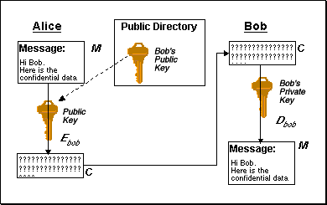
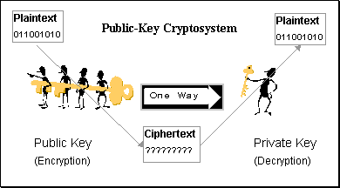
Asymmetric (Public-key) cryptography
When encrypting, you use their public key to write message and they use their private key to read it.

Slide 47
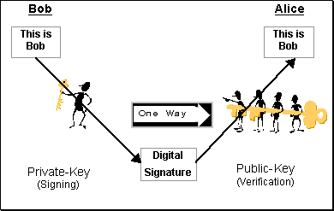
Digital signatures (Asymmetric cryptography) = Authentication
When signing, you use your private key to write message's signature, and they use your public key to check if it's really yours.

Slide 48
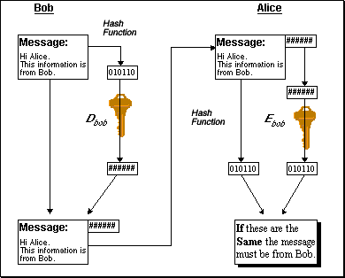
Digital signatures (with Hashing) = Authentication + Message integrity
Bob private key
Bob public key

